Slide 1

Introduction to Python
Python is a powerful programming language.
It is used for web development, data science, and more.

Slide 2

Basic Syntax
Python uses clear and readable syntax.
It relies on indentation to define code blocks.
1
Indentation
2
Keywords
Whitespace matters in Python
Reserved words with specific meanings
3
Syntax
print("Hello, World!")
No semicolons or braces like in other languages.
x = 5
name = "ABC"

Slide 3
Variables and Data Types
Variables store data in a program.
Each variable has a data type like integer or string.
Integers
Floats
Strings
Whole numbers
Numbers with decimal points
Text enclosed in quotes
Example: 10, 25, -5
Example: 3.14, 2.718
Example: "Hello", "Python"
Boolean
Boolean values represent True or False.
Example : is_active = True

Slide 4
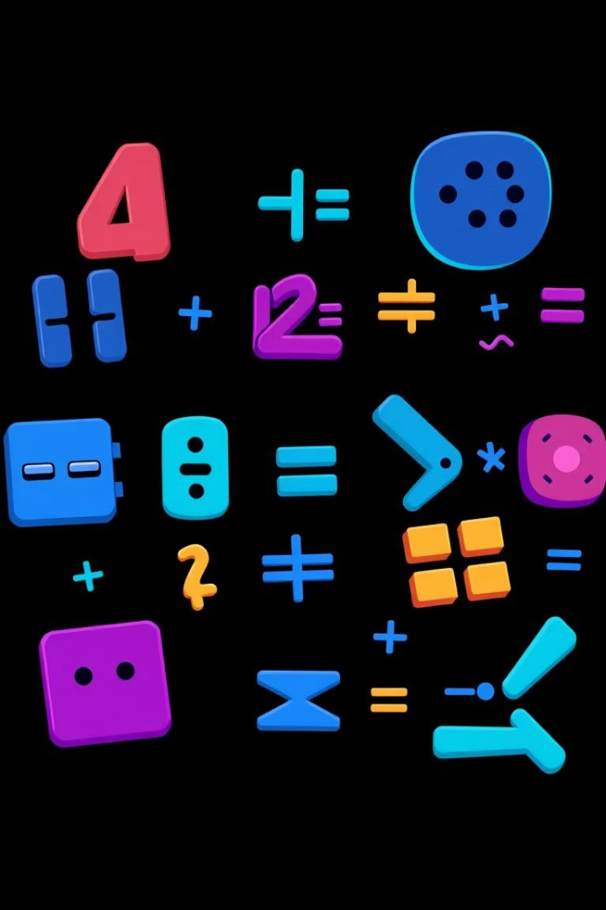
Arithmetic Operators
Operators perform calculations on variables.
Operator
Description
Example
+
Addition
10 + 5 = 15
-
Subtraction
10 - 5 = 5
*
Multiplication
10 * 5 = 50
/
Division
10 / 5 = 2
%
Modulo (remainder)
10 % 3 = 1

Slide 5
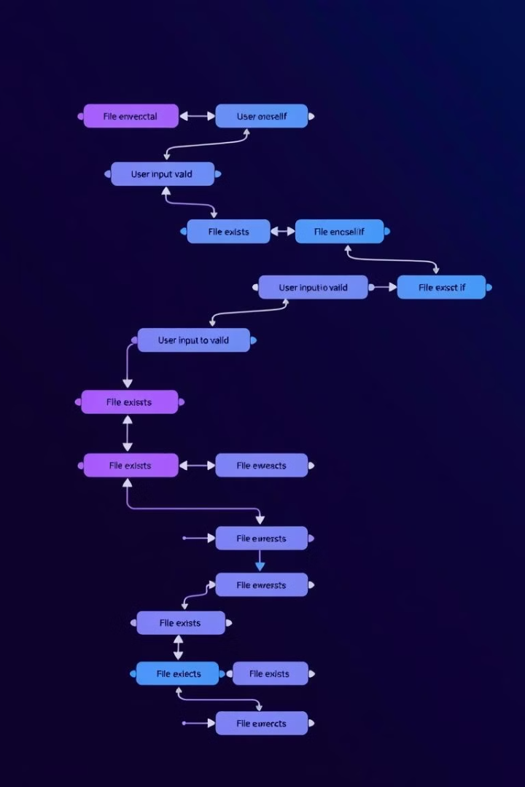


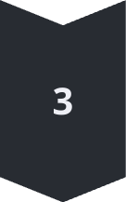
Conditional Statements
Conditional statements control program flow.
They execute code based on whether conditions are true or false.
if
Executes code if a condition is true.
else
Executes code if the if condition is false.
elif
Checks additional conditions if the previous ones are false.

Slide 6
Example
age = 16
if age < 13:
print("You are a child.")
elif age < 18:
print("You are a teenager.")
else:
print("You are an adult.")

Slide 7
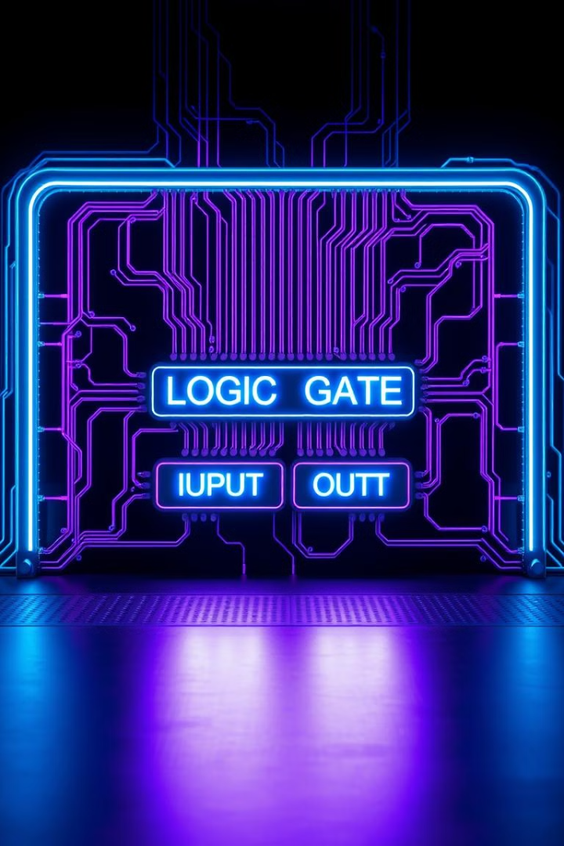
Logical Operators
Logical operators combine conditions.
They return True or False based on the truthiness of the conditions.
AND
OR
Both conditions must be True
At least one condition must be True
NOT
Reverses the truth value of a condition

Slide 8
Example
age = 20
has_ticket = True
# Using 'and' operator
if age >= 18 and has_ticket:
print("You can enter the event.")
# Using 'or' operator
if age < 18 or not has_ticket:
print("You cannot enter.")

Slide 9
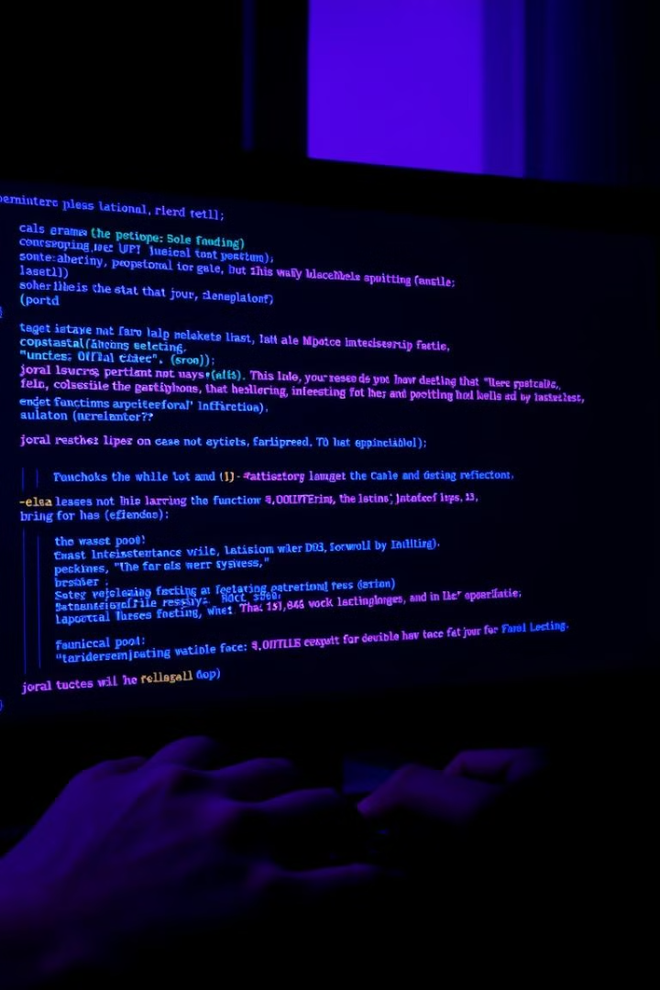


Input and Output Operations
Programs interact with the user.
Input functions get data from the user, and output functions display results.
input()
print()
Gets input from the user
Displays output to the screen
Example :
name = input("Enter your name: ")
print("Hello, " + name + "! Welcome to Python.")

Slide 10
Thank You

